Slide 1
7
Arrays and Vectors

Slide 2
OBJECTIVES
In this chapter you will learn:
To use the array data structure to represent a set of related data items.
To use arrays to store, sort and search lists and tables of values.
To declare arrays, initialize arrays and refer to the individual elements of arrays.
To pass arrays to functions.
Basic searching and sorting techniques.
To declare and manipulate multidimensional arrays.
To use C++ Standard Library class template vector.

Slide 3
7.1 Introduction
7.2 Arrays
7.3 Declaring Arrays
7.4 Examples Using Arrays
7.5 Passing Arrays to Functions
7.6 Case Study: Class GradeBook Using an Array to Store Grades
7.7 Searching Arrays with Linear Search
7.8 Sorting Arrays with Insertion Sort
7.9 Multidimensional Arrays
7.10 Case Study: Class GradeBook Using a Two-Dimensional Array
7.11 Introduction to C++ Standard Library Class Template vector
7.12 (Optional) Software Engineering Case Study: Collaboration Among Objects in the ATM System
7.13 Wrap-Up

Slide 4
7.1 Introduction
Arrays
  Data structures containing related data items of same type
  Always remain the same size once created
    Are “static” entities
  Character arrays can also represent strings
  C-style pointer-based arrays vs. vectors (object-based)
    Vectors are safer and more versatile

Slide 5
7.2 Arrays
Array
  Consecutive group of memory locations
    All of which have the same type
  Index
    Position number used to refer to a specific location/element
    Also called subscript
    Place in square brackets
      Must be positive integer or integer expression
    First element has index zero
    Example (assume a = 5 and b = 6)
      c[ a + b ] += 2;
        Adds 2 to array element c[ 11 ]

Slide 6
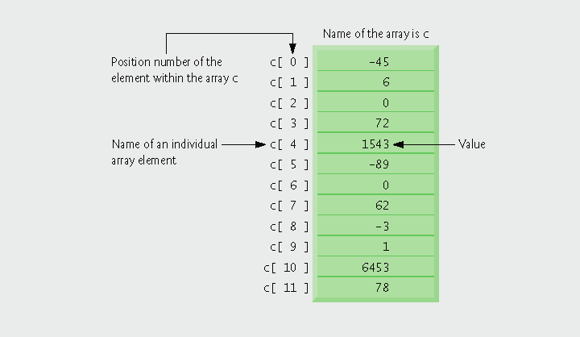
Fig.7.1 | Array of 12 elements

Slide 7
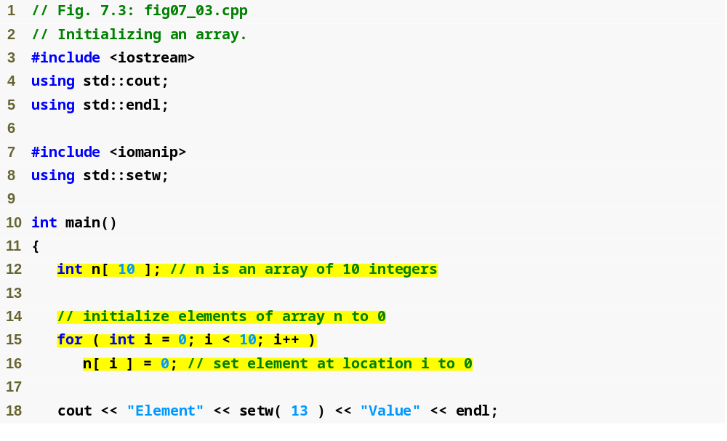
Outline
fig07_03.cpp
(1 of 2)
Declare n as an array of ints with 10 elements
Each int initialized is to 0

Slide 8
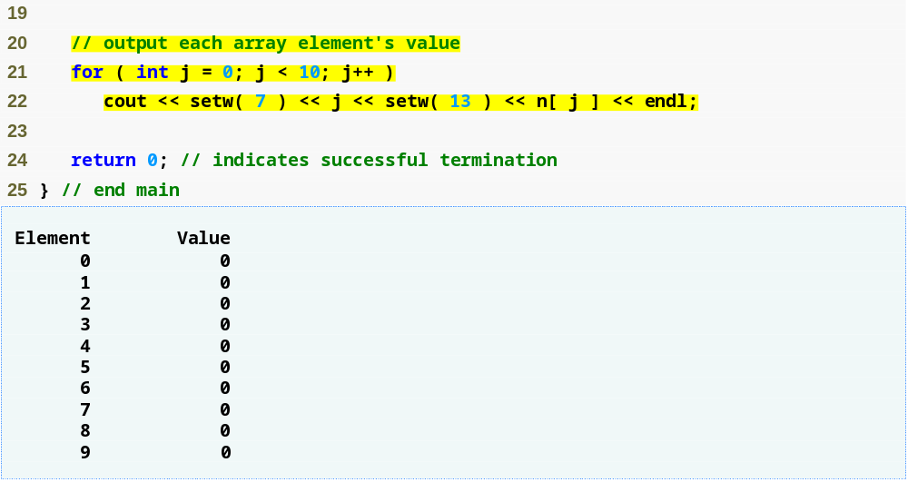
Outline
fig07_03.cpp
(2 of 2)
n[ j ] returns int associated with index j in array n
Each int has been initialized to 0

Slide 9
7.4 Examples Using Arrays (Cont.)
Initializing an array in a declaration with an initializer list
  Initializer list
    Items enclosed in braces ({})
    Items in list separated by commas
    Example
      int n[] = { 10, 20, 30, 40, 50 };
        Because array size is omitted in the declaration, the compiler determines the size of the array based on the size of the initializer list
        Creates a five-element array
        Index values are 0, 1, 2, 3, 4
        Initialized to values 10, 20, 30, 40, 50, respectively

Slide 10
7.4 Examples Using Arrays (Cont.)
Initializing an array in a declaration with an initializer list (Cont.)
  If fewer initializers than elements in the array
    Remaining elements are initialized to zero
    Example
      int n[ 10 ] = { 10, 10 };
        Explicitly initializes first 2 elements to ten
        Implicitly initializes remaining eight elements to zero
  If more initializers than elements in the array
    Compilation error

Slide 11
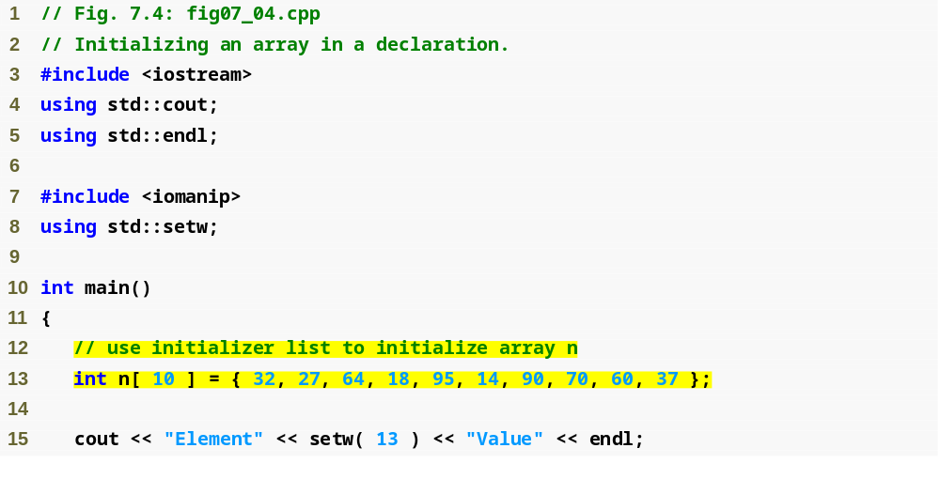
Outline
fig07_04.cpp
(1 of 2)
Declare n as an array of ints
Compiler uses initializer list to initialize array

Slide 12
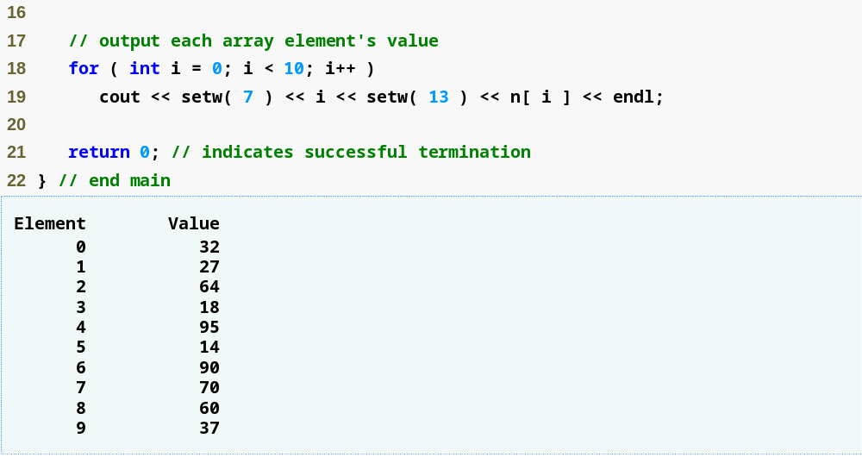
Outline
fig07_04.cpp
(2 of 2)

Slide 13
7.4 Examples Using Arrays (Cont.)
Specifying an array’s size with a constant variable and setting array elements with calculations
  Initialize elements of 10-element array to even integers
  Use repetition statement that calculates value for current element, initializes array element using calculated value

Slide 14
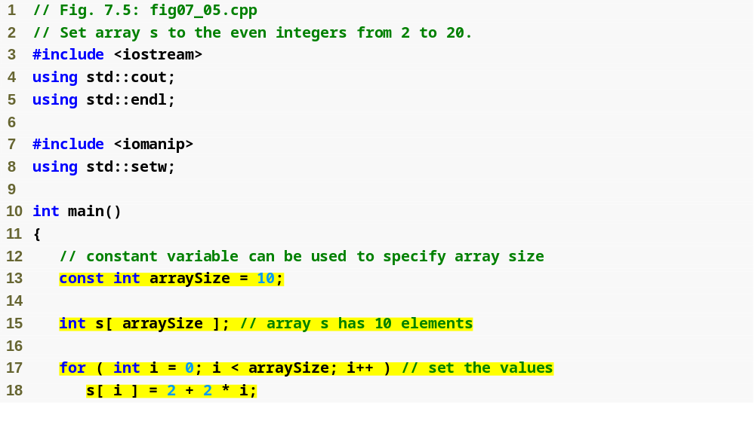
Outline
fig07_05.cpp
(1 of 2)
Declare constant variable arraySize using the const keyword
Declare array that contains 10 ints
Use array index to assign element’s value

Slide 15
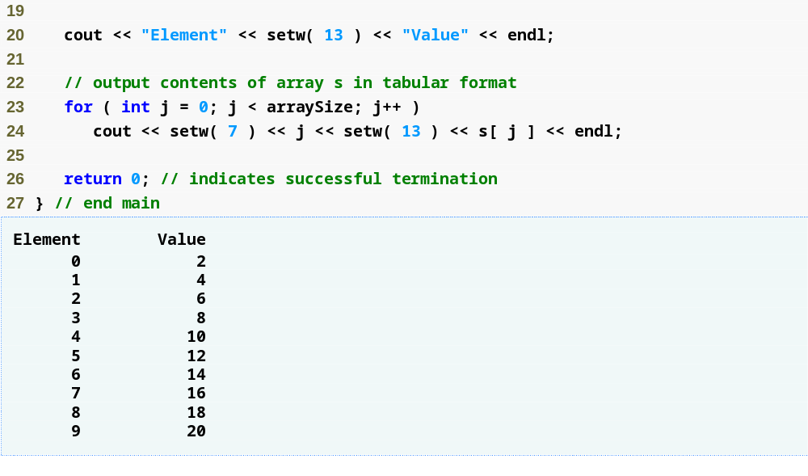
Outline
fig07_05.cpp
(2 of 2)

Slide 16
7.4 Examples Using Arrays (Cont.)
Constant variables
  Declared using the const qualifier
  Also called name constants or read-only variables
  Must be initialized with a constant expression when they are declared and cannot be modified thereafter
  Can be placed anywhere a constant expression is expected
  Using constant variables to specify array sizes makes programs more scalable and eliminates “magic numbers”

Slide 17
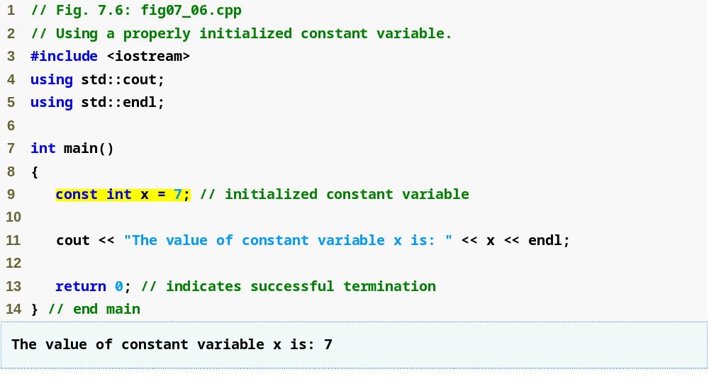
Outline
fig07_06.cpp
(1 of 1)
Declaring constant value

Slide 18
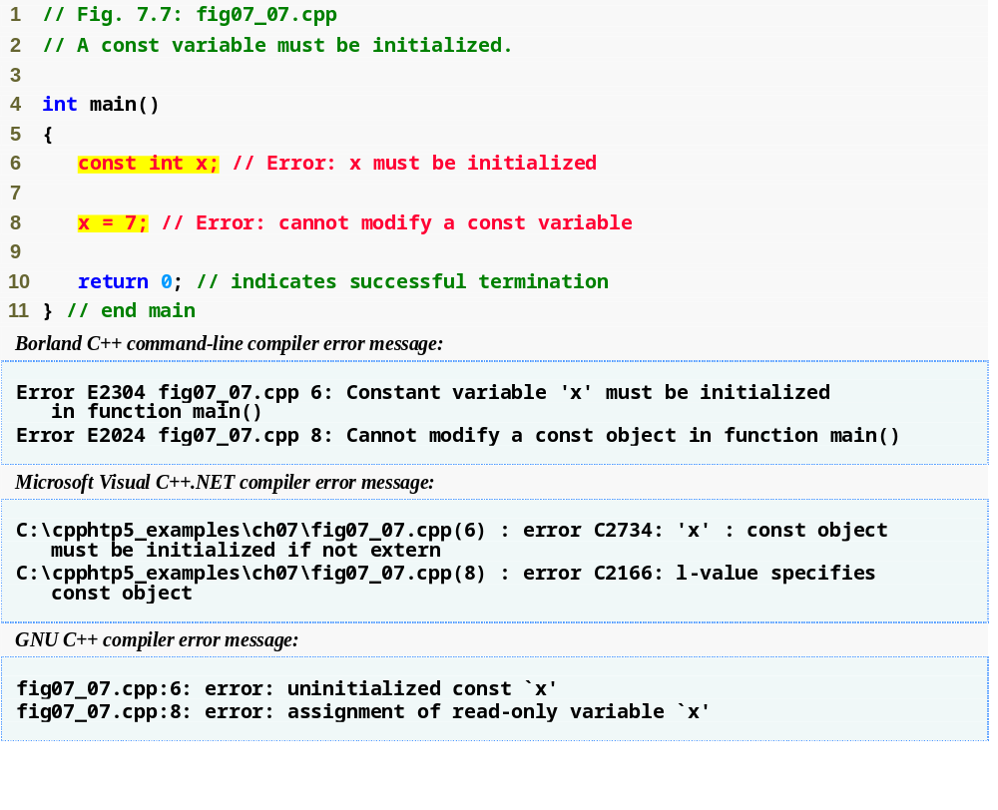
Outline
Must initialize a constant at the time of declaration
Cannot modify a constant
fig07_07.cpp
(1 of 1)
Error messages differ based on the compiler

Slide 19
7.4 Examples Using Arrays (Cont.)
Using bar charts to display array data graphically
  Present data in graphical manner
    E.g., bar chart
  Examine the distribution of grades
  Nested for statement used to output bars

Slide 20
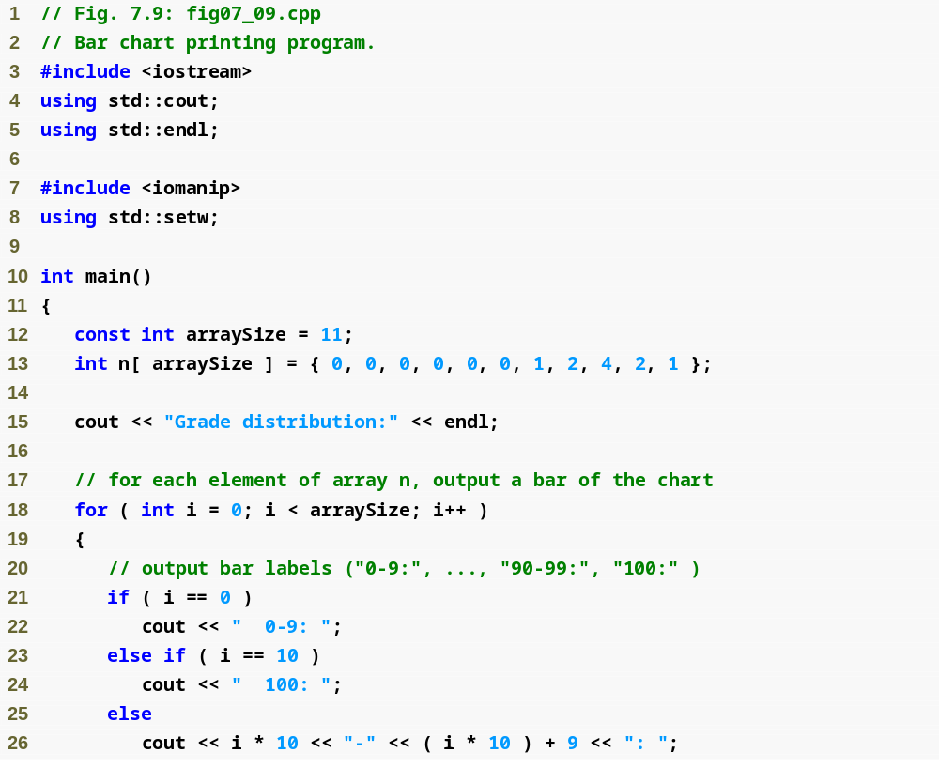
Outline
fig07_09.cpp
(1 of 2)
Declare array with initializer list

Slide 21
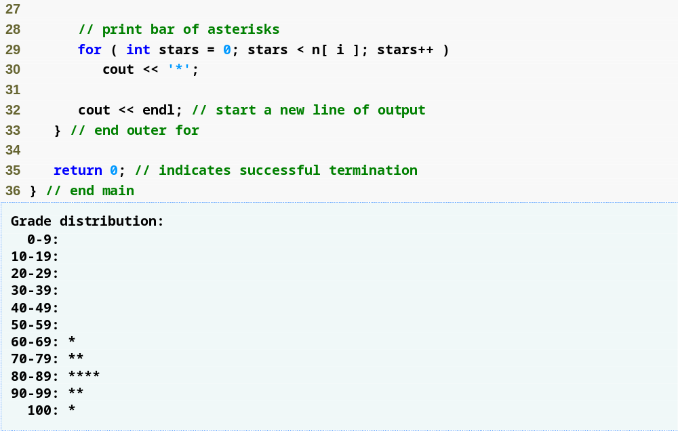
Outline
For each array element, print the associated number of asterisks
fig07_09.cpp
(2 of 2)

Slide 22
7.4 Examples Using Arrays (Cont.)
Using the elements of an array as counters
  Use a series of counter variables to summarize data
  Counter variables make up an array
  Store frequency values

Slide 23
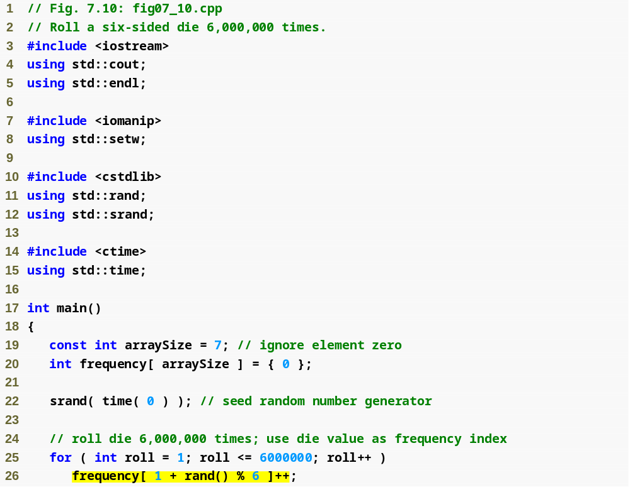
Outline
fig07_10.cpp
(1 of 2)
Declare frequency as array of 7 ints
Generate 6000000 random integers in range 1 to 6
Increment frequency values at the index associated with the random number

Slide 24
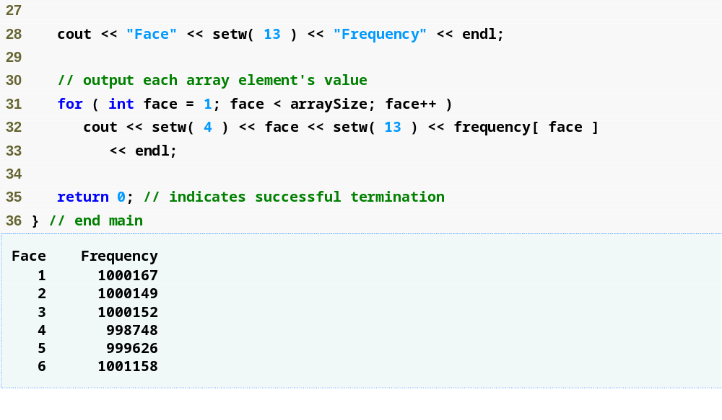
Outline
fig07_10.cpp
(2 of 2)

Slide 25
7.4 Examples Using Arrays (Cont.)
Using arrays to summarize survey results
  40 students rate the quality of food
    1-10 rating scale: 1 means awful, 10 means excellent
  Place 40 responses in an array of integers
  Summarize results
  Each element of the array used as a counter for one of the survey responses
C++ has no array bounds checking
  Does not prevent the computer from referring to an element that does not exist
    Could lead to serious execution-time errors

Slide 26
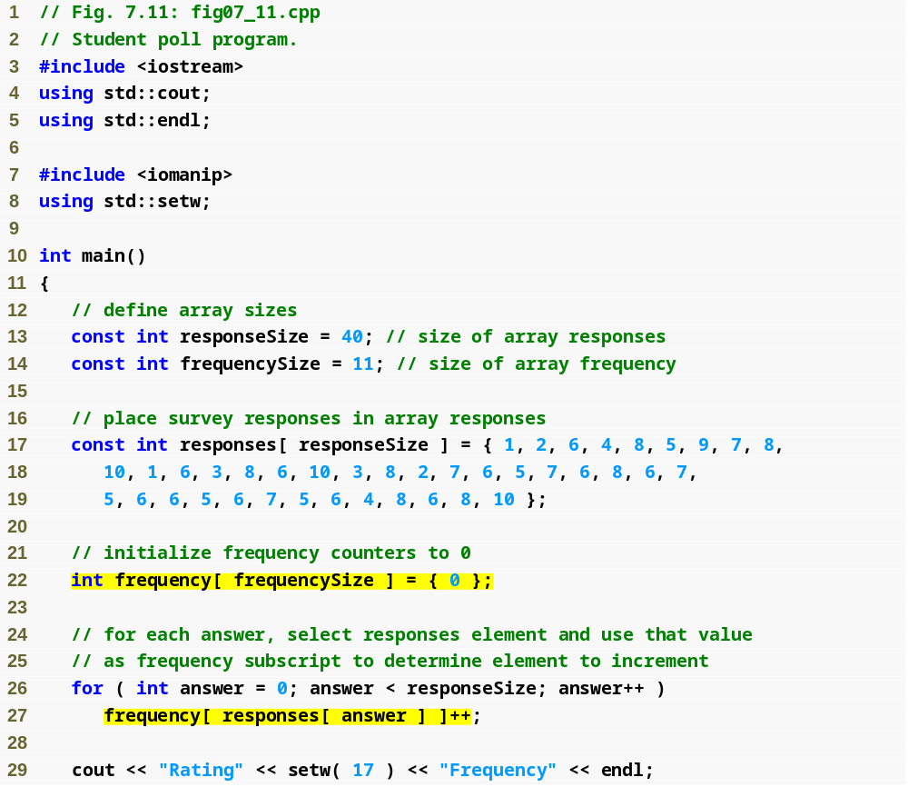
Outline
fig07_11.cpp
(1 of 2)
Array responses will store 40 responses
Array frequency will contain 11 ints (ignore the first element)
Initialize responses with 40 responses
Initialize frequency to all 0s
For each response, increment frequency value at the index associated with that response

Slide 27
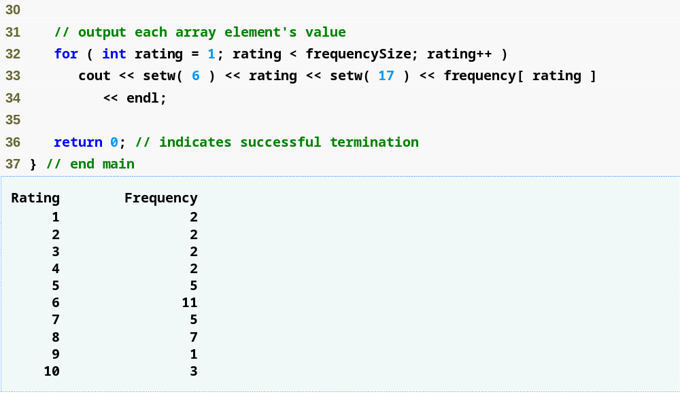
Outline
fig07_11.cpp
(2 of 2)

Slide 28
7.4 Examples Using Arrays (Cont.)
Using character arrays to store and manipulate strings
  Arrays may be of any type, including chars
    We can store character strings in char arrays
  Can be initialized using a string literal
    Example
      char string1[] = "Hi";
    Equivalent to
      char string1[] = { 'H', 'i', '\0' };
  Array contains each character plus a special string-termination character called the null character ('\0')

Slide 29
7.4 Examples Using Arrays (Cont.)
Using character arrays to store and manipulate strings (Cont.)
  Can also be initialized with individual character constants in an initializer list
  char string1[] =
  { 'f', 'i', 'r', 's', 't', '\0' };
  Can also input a string directly into a character array from the keyboard using cin and >>
  cin >> string1;
    cin >> may read more characters than the array can store
  A character array representing a null-terminated string can be output with cout and <<

Slide 30
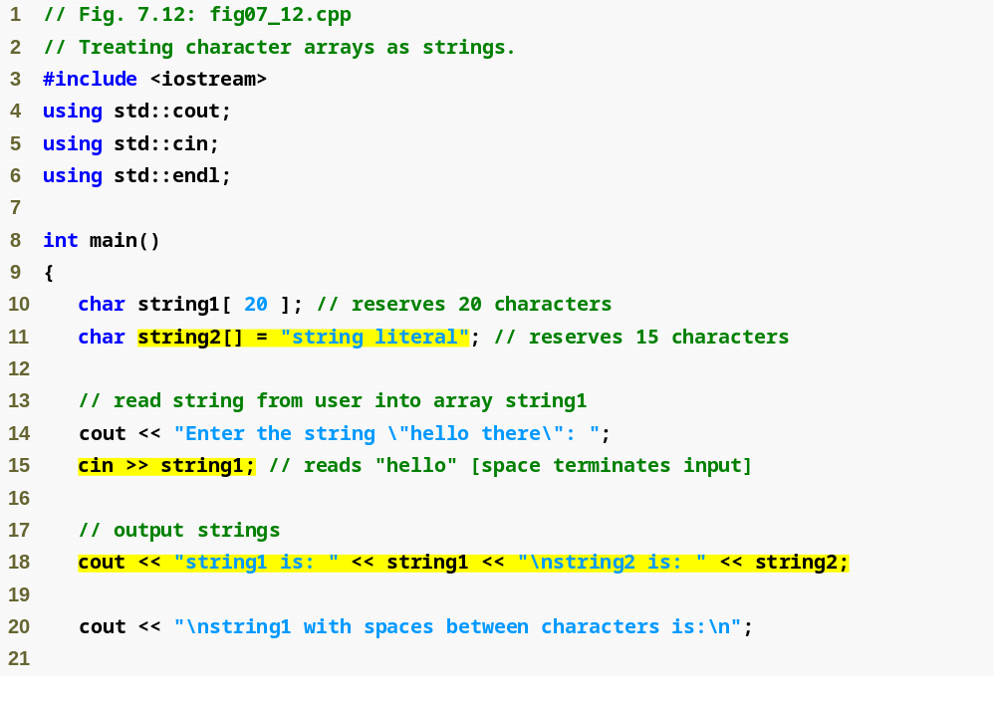
Outline
fig07_12.cpp
(1 of 2)
Store "string literal" as an array of characters
Initializing an array of characters using cin
Output array using cin

Slide 31
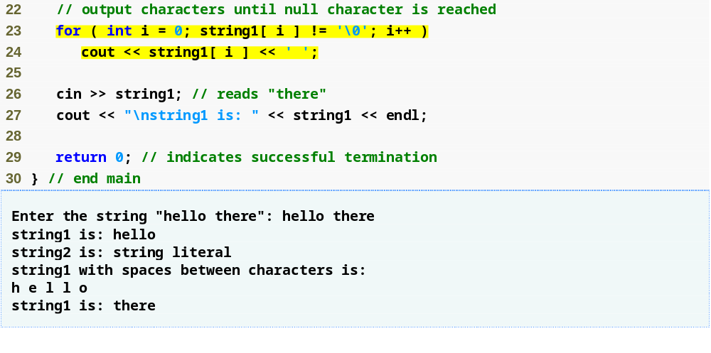
Outline
Loop until the terminating null character is reached
Accessing specific characters in the array
fig07_12.cpp
(2 of 2)

Slide 32
7.4 Examples Using Arrays (Cont.)
static local arrays and automatic local arrays
  A static local variable in a function
    Exists for the duration of the program
    But is visible only in the function body
  A static local array
    Exists for the duration of the program
    Is initialized when its declaration is first encountered
      All elements are initialized to zero if not explicitly initialized
        This does not happen for automatic local arrays

Slide 33
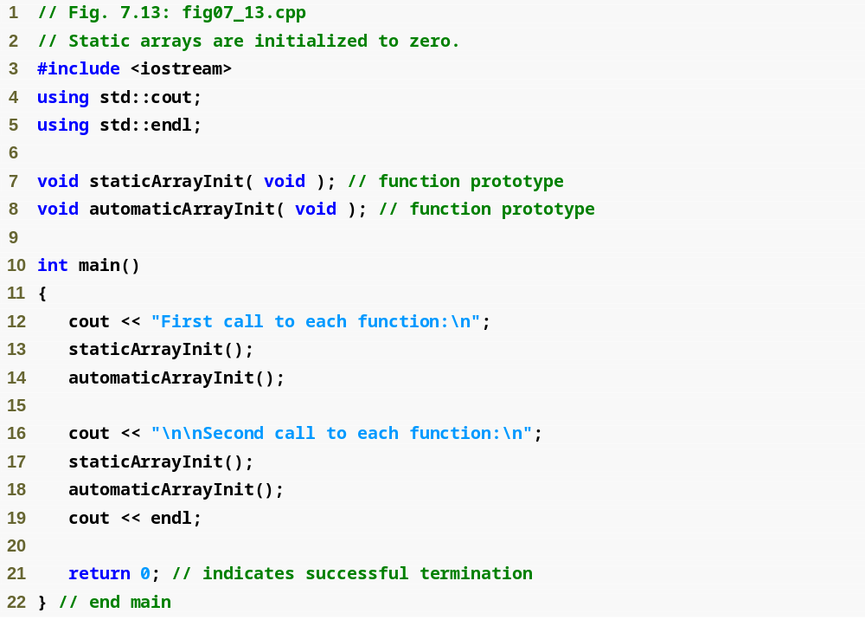
Outline
fig07_13.cpp
(1 of 3)

Slide 34
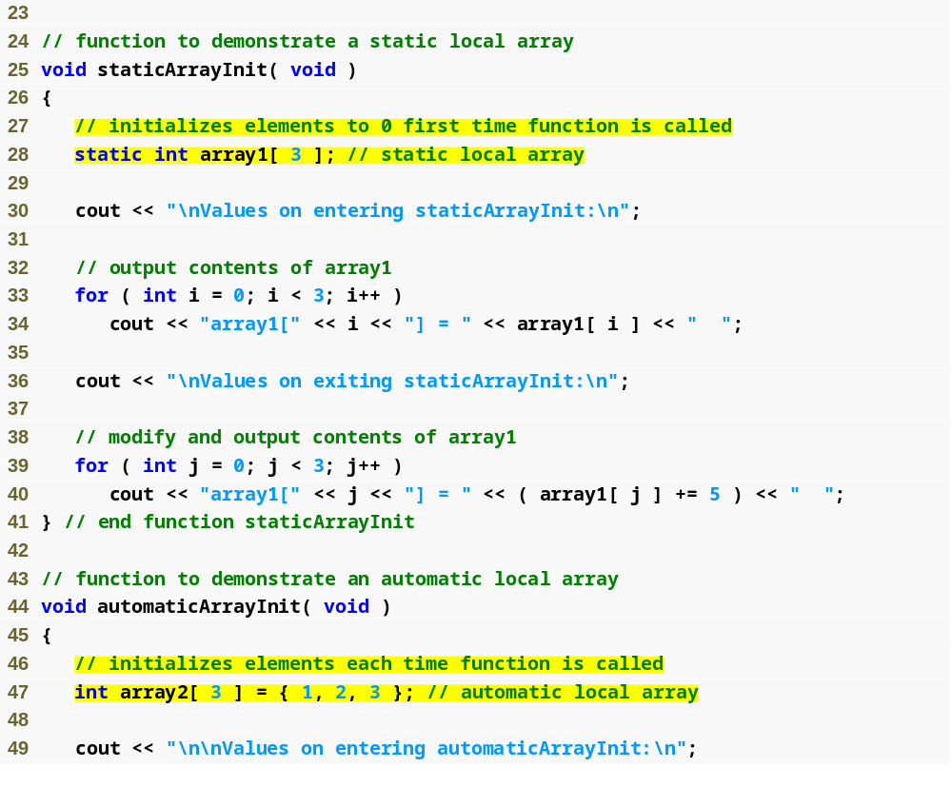
Outline
fig07_13.cpp
(2 of 3)
Create a static array using keyword static
Create an automatic local array

Slide 35
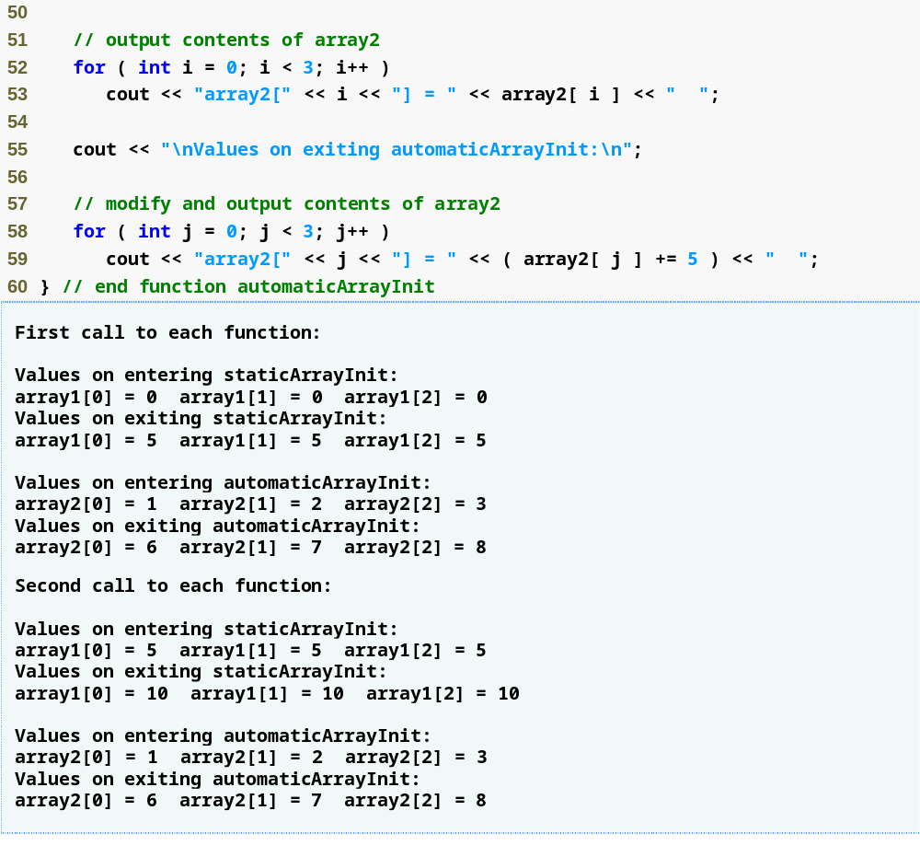
Outline
fig07_13.cpp
(3 of 3)
Values reflect changes from the previous function call – the array was not reinitialized

Slide 36
7.5 Passing Arrays to Functions
To pass an array argument to a function
  Specify array name without brackets
    Array hourlyTemperatures is declared as
    int hourlyTemperatures[ 24 ];
    The function call
    modifyArray( hourlyTemperatures, 24 );
    passes array hourlyTemperatures and its size to function modifyArray
  Array size is normally passed as another argument so the function can process the specific number of elements in the array

Slide 37
7.5 Passing Arrays to Functions (Cont.)
Arrays are passed by reference
  Function call actually passes starting address of array
    So function knows where array is located in memory
  Caller gives called function direct access to caller’s data
    Called function can manipulate this data

Slide 38
7.5 Passing Arrays to Functions (Cont.)
Individual array elements passed by value
  Single pieces of data
    Known as scalars or scalar quantities
  To pass an element to a function
    Use the subscripted name of the array element as an argument
Functions that take arrays as arguments
  Function parameter list must specify array parameter
    Example
      void modArray( int b[], int arraySize );

Slide 39
7.5 Passing Arrays to Functions (Cont.)
Functions that take arrays as arguments (Cont.)
  Array parameter may include the size of the array
    Compiler will ignore it, though
      Compiler only cares about the address of the first element
Function prototypes may include parameter names
  But the compiler will ignore them
  Parameter names may be left out of function prototypes

Slide 40
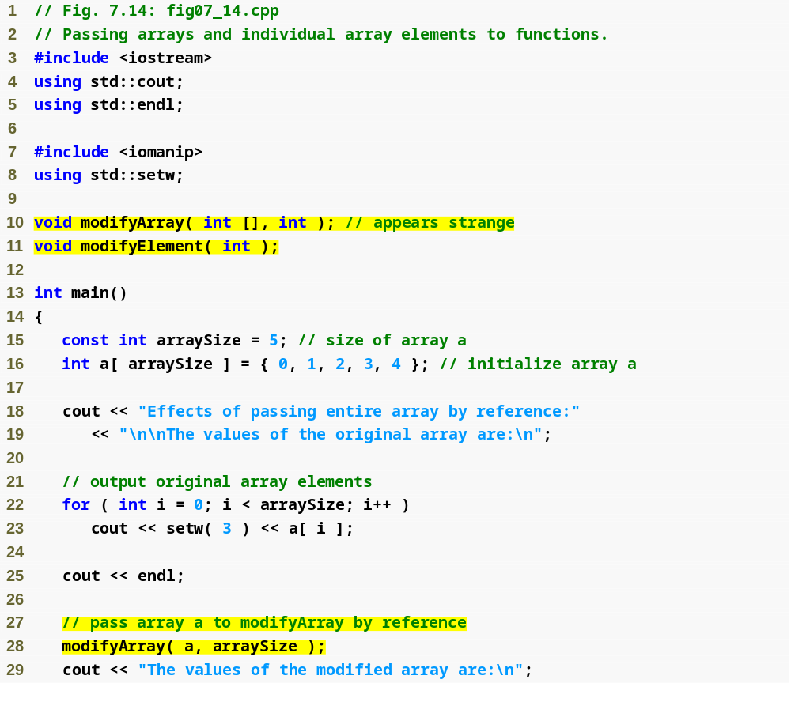
Outline
Function takes an array as argument
fig07_14.cpp
(1 of 3)
Declare 5-int array array with initializer list
Pass entire array to function modifyArray

Slide 41
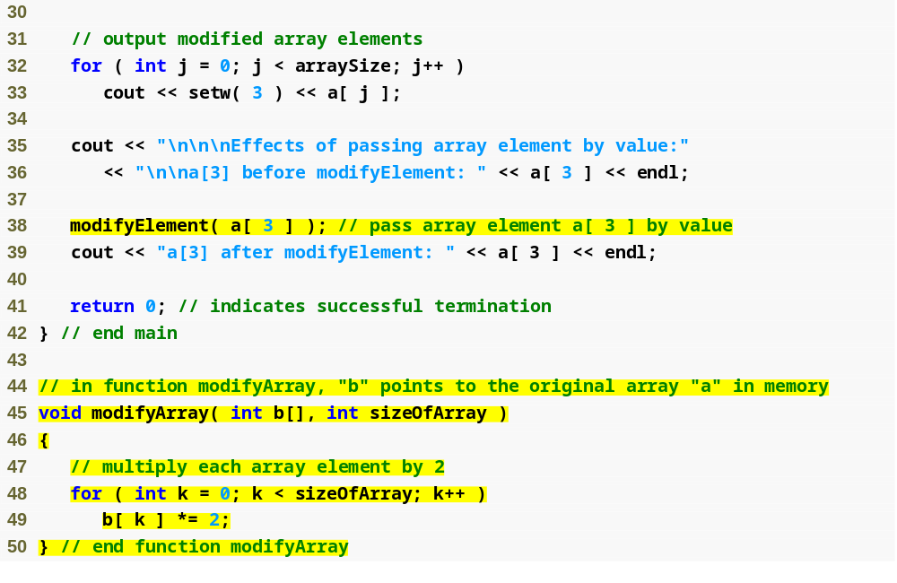
Outline
Pass array element a[ 3 ] to function modifyElement
fig07_14.cpp
(2 of 3)
Function modifyArray manipulates the array directly

Slide 42
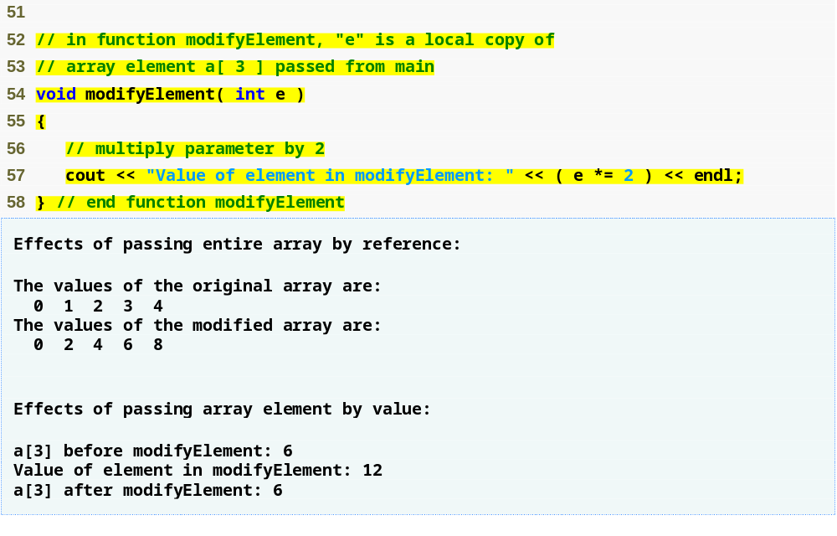
Outline
Function modifyElement manipulates array element’s copy
fig07_14.cpp
(3 of 3)

Slide 43
7.5 Passing Arrays to Functions (Cont.)
const array parameters
  Qualifier const
  Prevent modification of array values in the caller by code in the called function
  Elements in the array are constant in the function body
  Enables programmer to prevent accidental modification of data

Slide 44
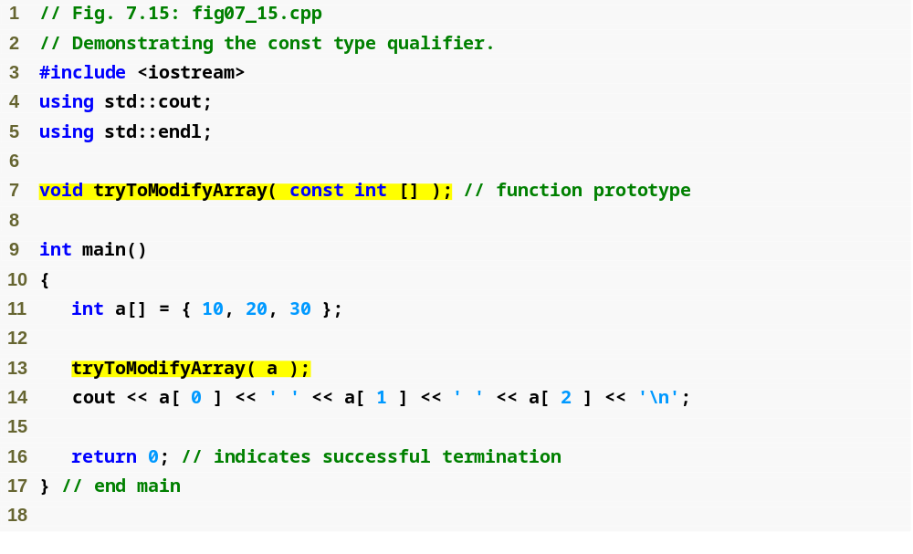
Outline
Using const to prevent the function from modifying the array
fig07_15.cpp
(1 of 2)
Array a will be const when in the body of the function

Slide 45
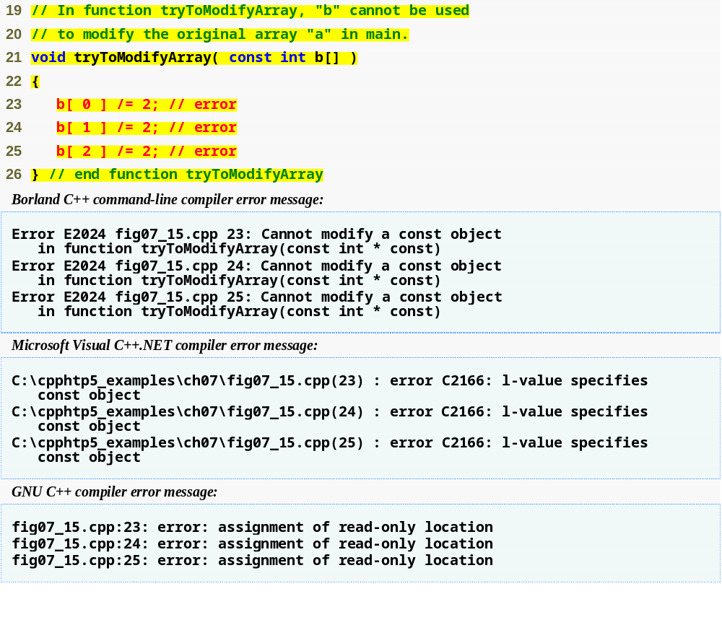
Outline
Array cannot be modified; it is const within the body function
fig07_15.cpp
(2 of 2)

Slide 46
7.6 Case Study: Class GradeBook Using an Array to Store Grades
Class GradeBook
  Represent a grade book that stores and analyzes grades
  Can now store grades in an array
static data members
  Also called class variables
  Variables for which each object of a class does not have a separate copy
    One copy is shared among all objects of the class
  Can be accessed even when no objects of the class exist
    Use the class name followed by the binary scope resolution operator and the name of the static data member

Slide 47
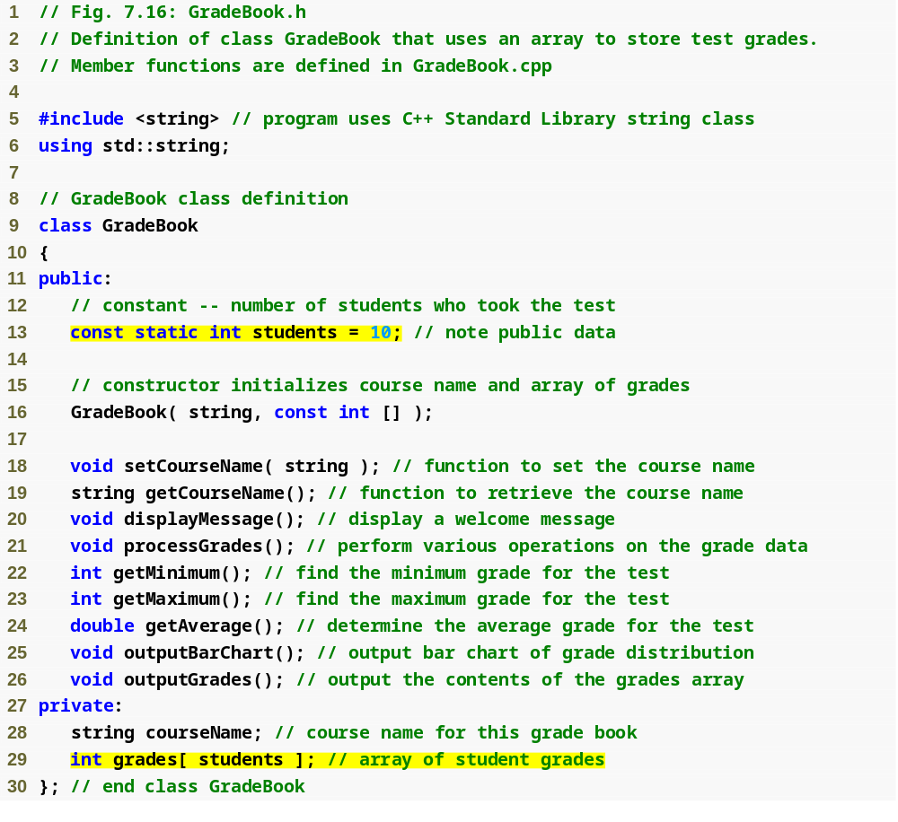
Outline
students is a static class variable
fig07_16.cpp
(1 of 1)
Number of students we will be keeping track of
Declare array grades to store individual grades

Slide 48
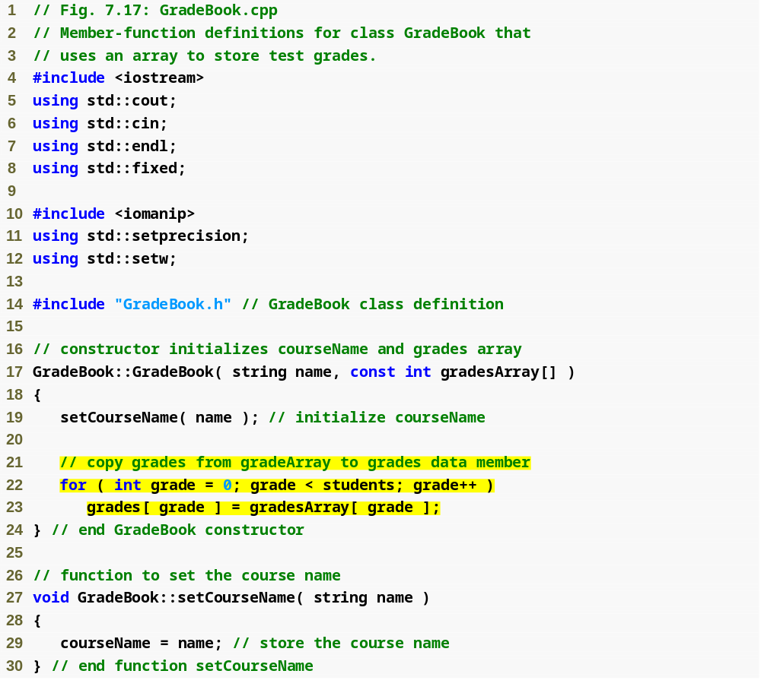
Outline
fig07_17.cpp
(1 of 6)
Copy elements from gradesArray to data member grades

Slide 49
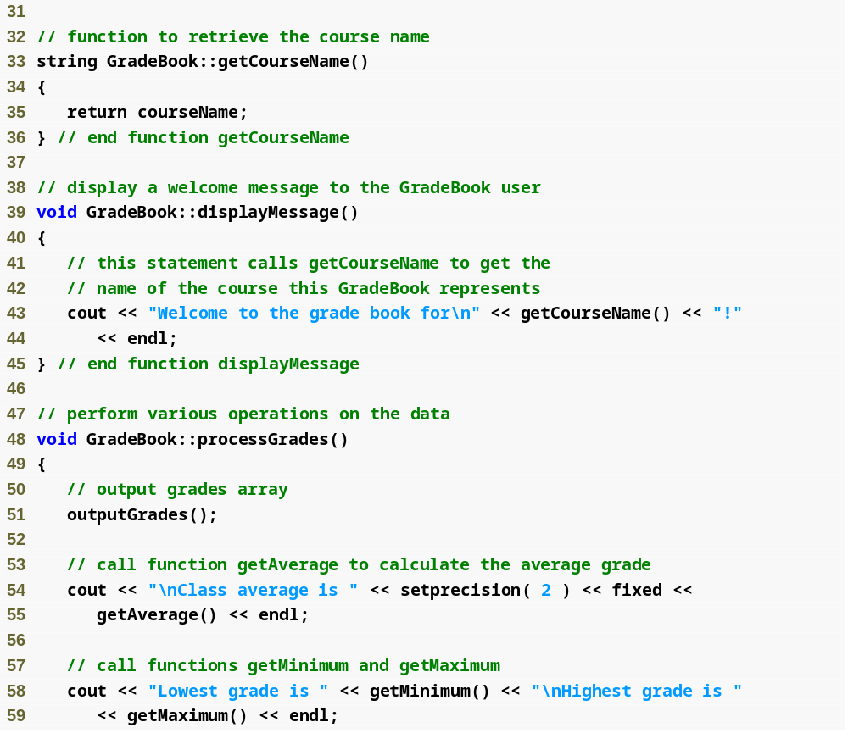
Outline
fig07_17.cpp
(2 of 6)

Slide 50
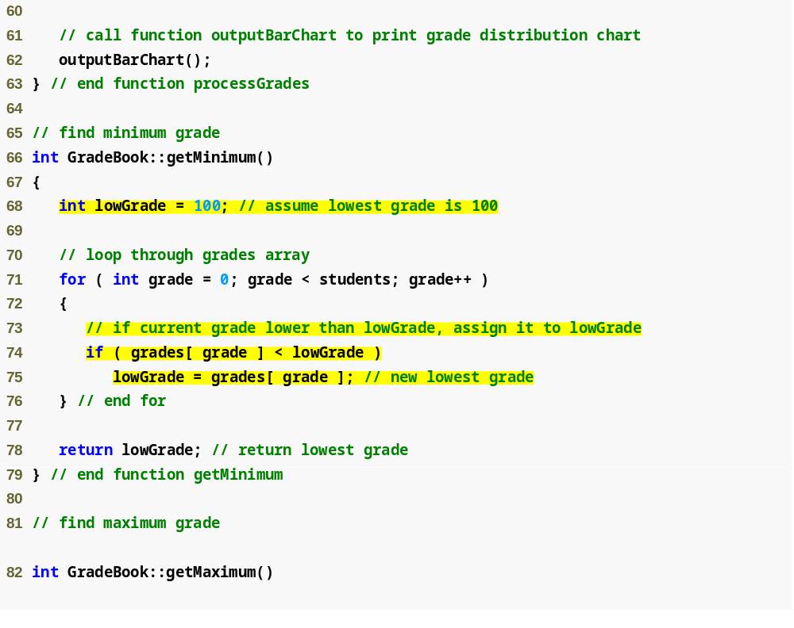
Outline
fig07_17.cpp
(3 of 6)
Loop through grades to find the lowest grade

Slide 51
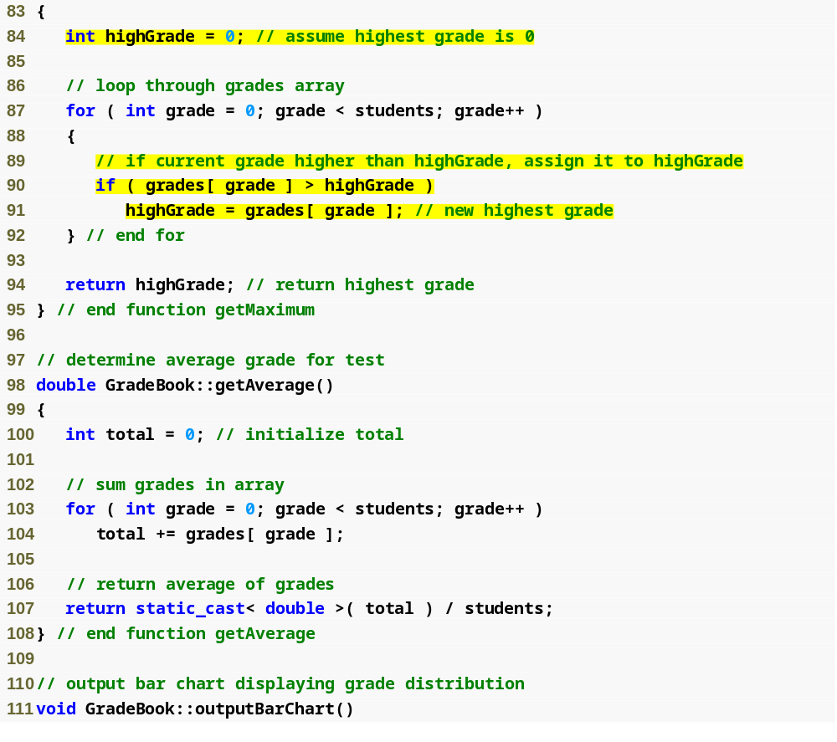
Outline
Loop through grades to find the highest grade
fig07_17.cpp
(4 of 6)
Loop through grades to sum grades for all students
Divide the total by the number of students to calculate the average grade

Slide 52
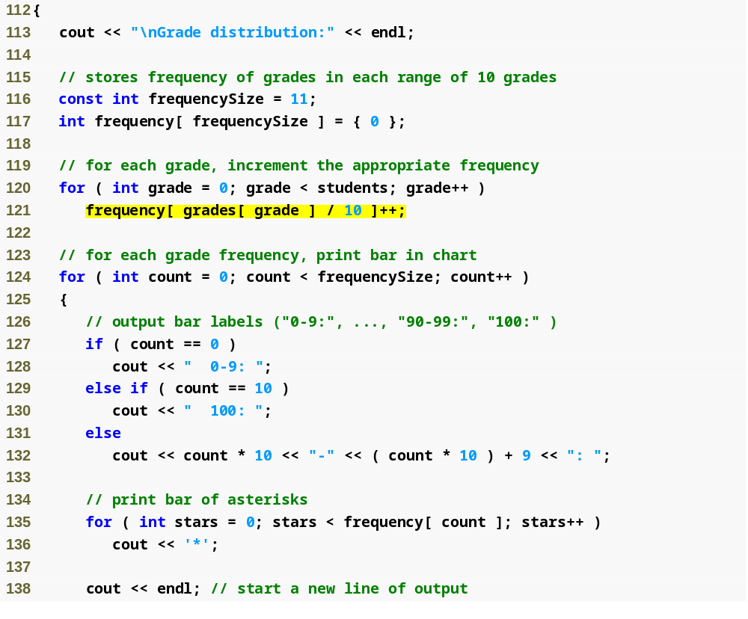
Outline
fig07_17.cpp
(5 of 6)
Loop through grades to calculate frequency
Display asterisks to show a bar for each grade range

Slide 53
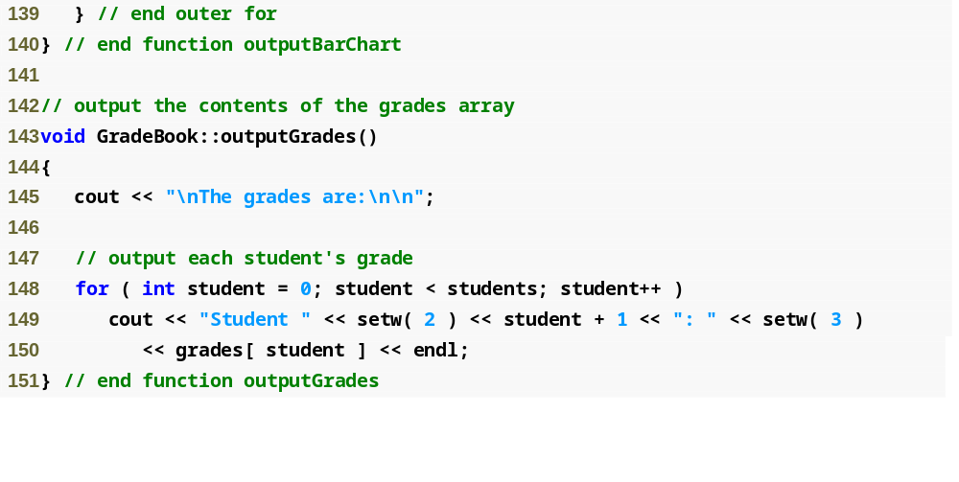
Outline
fig07_17.cpp
(6 of 6)
Displaying each grade

Slide 54
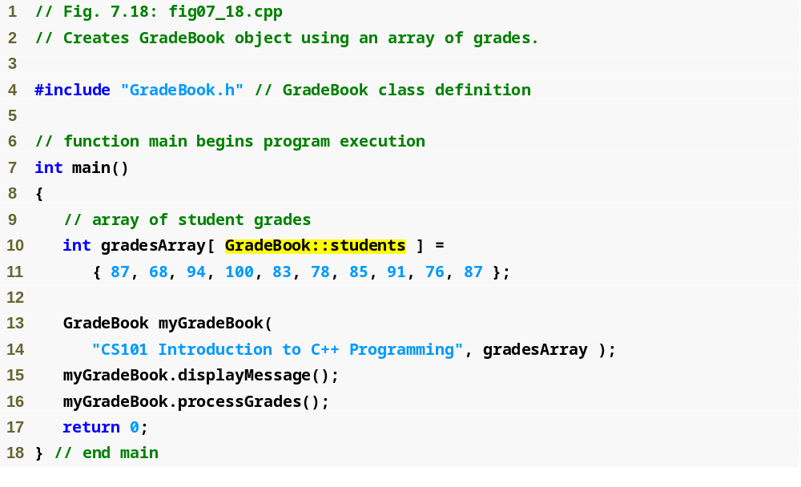
Outline
Use static data member students of class GradeBook
fig07_18.cpp
(1 of 2)
Declare and initialize gradesArray with 10 elements
Pass gradesArray to GradeBook constructor

Slide 55
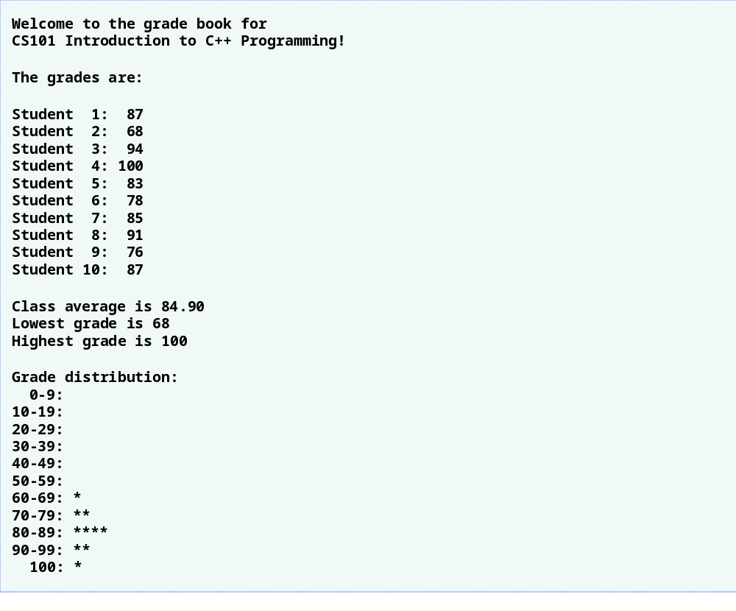
Outline
fig07_18.cpp
(2 of 2)

Slide 56
7.9 Multidimensional Array
Multidimensional arrays with two dimensions
  Called two dimensional or 2-D arrays
  Represent tables of values with rows and columns
  Elements referenced with two subscripts ([ x ][ y ])
  In general, an array with m rows and n columns is called an m-by-n array
Multidimensional arrays can have more than two dimensions

Slide 57
7.9 Multidimensional Array (Cont.)
Declaring and initializing two-dimensional arrays
  Declaring two-dimensional array b
    int b[ 2 ][ 2 ] = { { 1, 2 }, { 3, 4 } };
      1 and 2 initialize b[ 0 ][ 0 ] and b[ 0 ][ 1 ]
      3 and 4 initialize b[ 1 ][ 0 ] and b[ 1 ][ 1 ]
    int b[ 2 ][ 2 ] = { { 1 }, { 3, 4 } };
      Row 0 contains values 1 and 0 (implicitly initialized to zero)
      Row 1 contains values 3 and 4

Slide 58
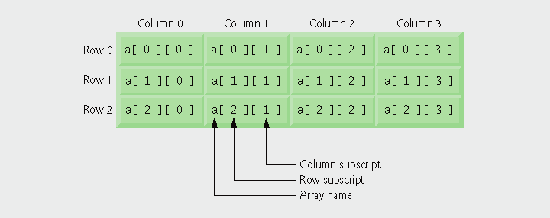
Fig.7.21 | Two-dimensional array with three rows and four columns.

Slide 59
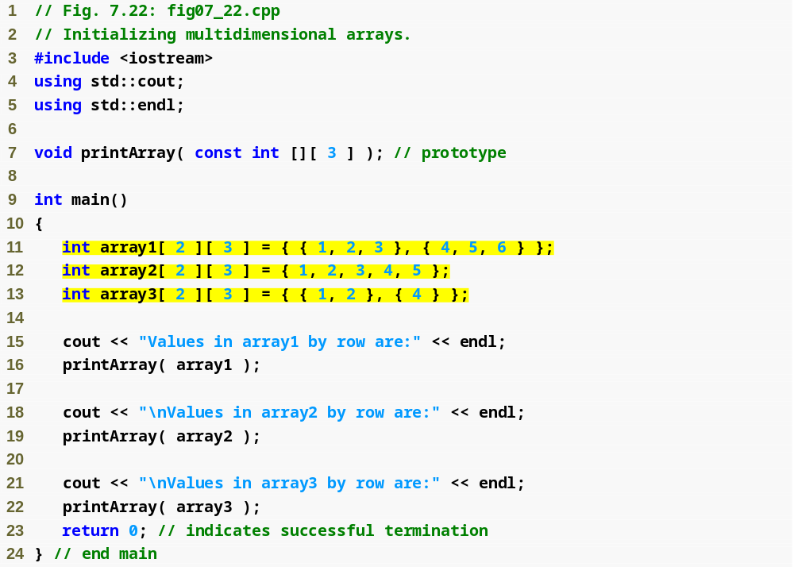
Outline
fig07_22.cpp
(1 of 2)
Use nested array initializers to initialize arrays

Slide 60
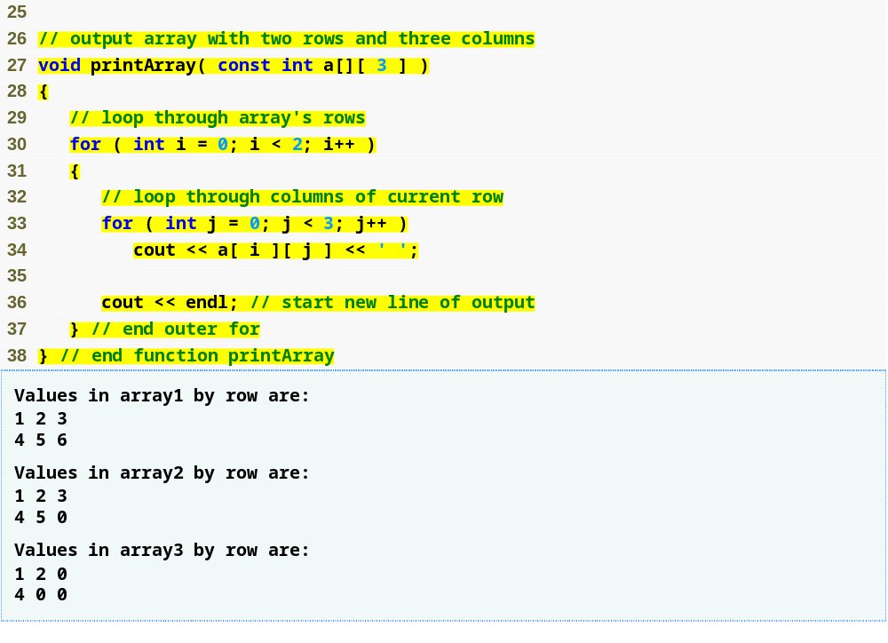
Outline
fig07_22.cpp
(2 of 2)
Use nested for loops to print array

Slide 61
7.9 Multidimensional Array (Cont.)
Multidimensional array parameters
  Size of first dimension is not required
    As with a one-dimensional array
  Size of subsequent dimensions are required
    Compiler must know how many elements to skip to move to the second element in the first dimension
  Example
    void printArray( const int a[][ 3 ] );
      Function will skip row 0’s 3 elements to access row 1’s elements (a[ 1 ][ x ])

Slide 62
7.9 Multidimensional Array (Cont.)
Multidimensional-array manipulations
  Commonly performed with for statements
    Example
      Modify all elements in a row
        for ( int col = 0; col < 4; col++ )
        a[ 2 ][ col ] = 0;
    Example
      Total all elements
        total = 0;
        for ( row = 0; row < 3; row++ )
        for ( col = 0; col < 4; col++ )
        total += a[ row ][ col ];

Slide 63
7.11 Introduction to C++ Standard Library Class Template vector
C-style pointer-based arrays
  Have great potential for errors and several shortcomings
    C++ does not check whether subscripts fall outside the range of the array
    Two arrays cannot be meaningfully compared with equality or relational operators
    One array cannot be assigned to another using the assignment operators

Slide 64
7.11 Introduction to C++ Standard Library Class Template vector (Cont.)
Class template vector
  Available to anyone building applications with C++
  Can be defined to store any data type
    Specified between angle brackets in vector< type >
    All elements in a vector are set to 0 by default
  Member function size obtains size of array
    Number of elements as a value of type size_t
  vector objects can be compared using equality and relational operators
  Assignment operator can be used for assigning vectors

Slide 65
7.11 Introduction to C++ Standard Library Class Template vector (Cont.)
vector elements can be obtained as an unmodifiable lvalue or as a modifiable lvalue
  Unmodifiable lvalue
    Expression that identifies an object in memory, but cannot be used to modify that object
  Modifiable lvalue
    Expression that identifies an object in memory, can be used to modify the object

Slide 66
7.11 Introduction to C++ Standard Library Class Template vector (Cont.)
vector member function at
  Provides access to individual elements
  Performs bounds checking when using “at()” method
    Throws an exception when specified index is invalid
    Accessing with square brackets does not perform bounds checking

Slide 67
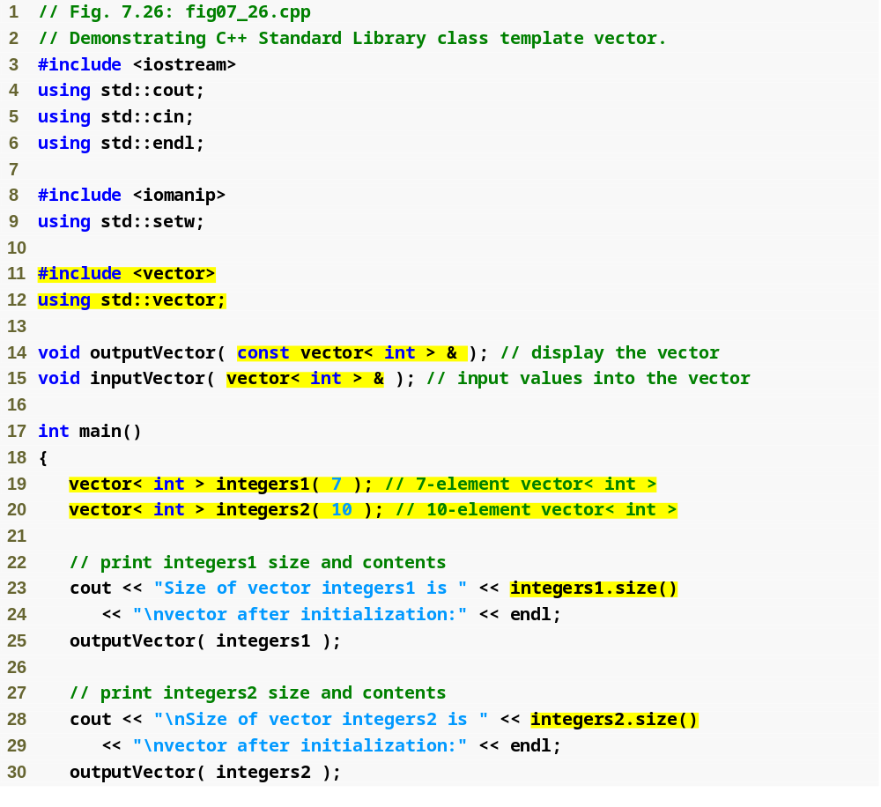
Outline
Using const prevents outputVector from modifying the vector passed to it
fig07_26.cpp
(1 of 6)
These vectors will store ints
Function size returns number of elements in the vector

Slide 68
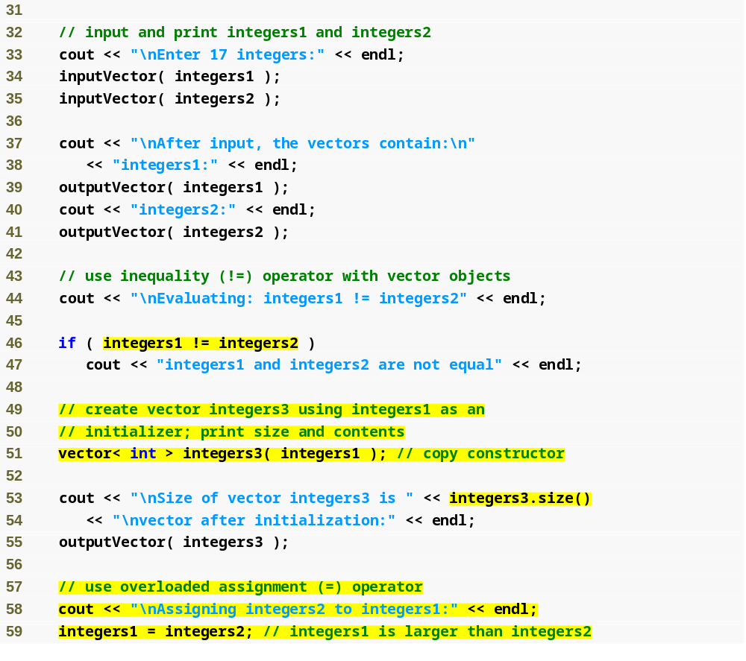
Outline
fig07_26.cpp
(2 of 6)
Comparing vectors using !=
Copying data from one vector to another
Assigning data from one vector to another

Slide 69
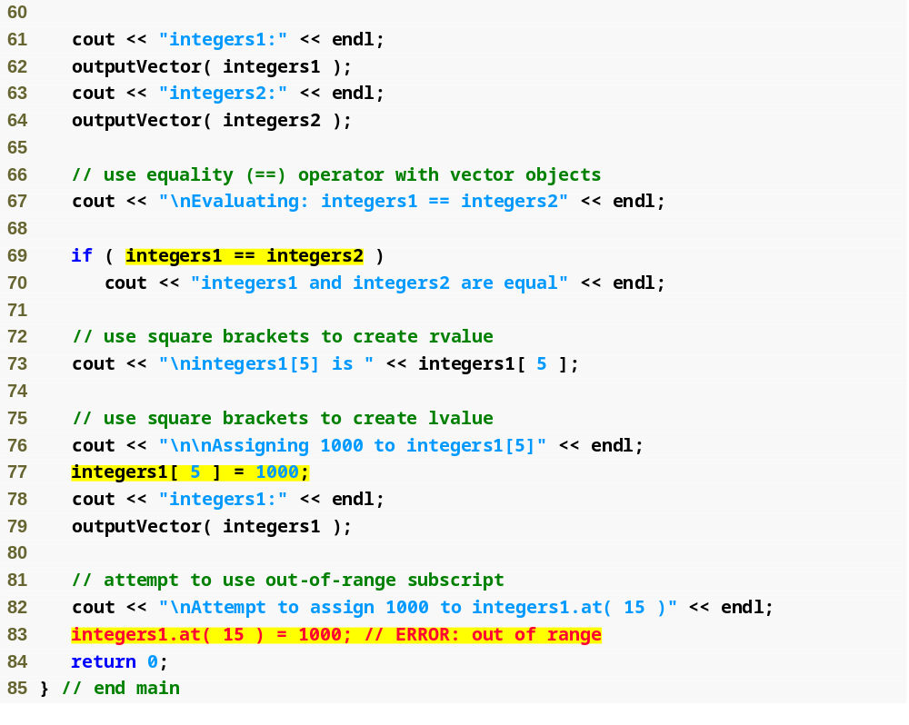
Outline
fig07_26.cpp
(3 of 6)
Comparing vectors using ==
Displaying a value in the vector
Updating a value in the vector
Function at provides bounds checking

Slide 70
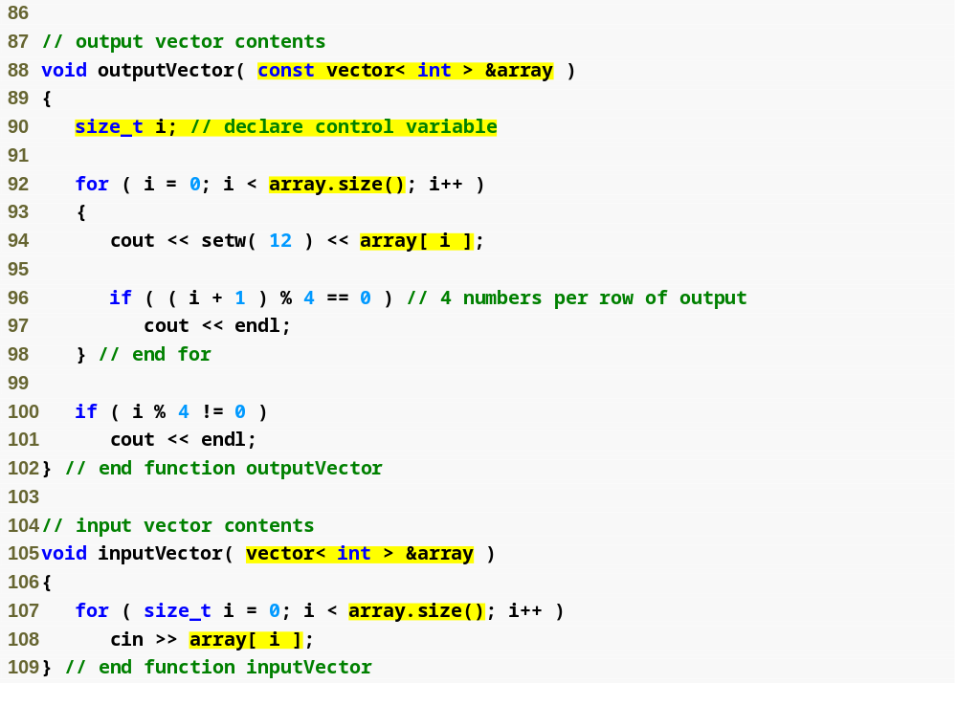
Outline
fig07_26.cpp
(4 of 6)
Display each vector element
Input vector values using cin

Slide 71
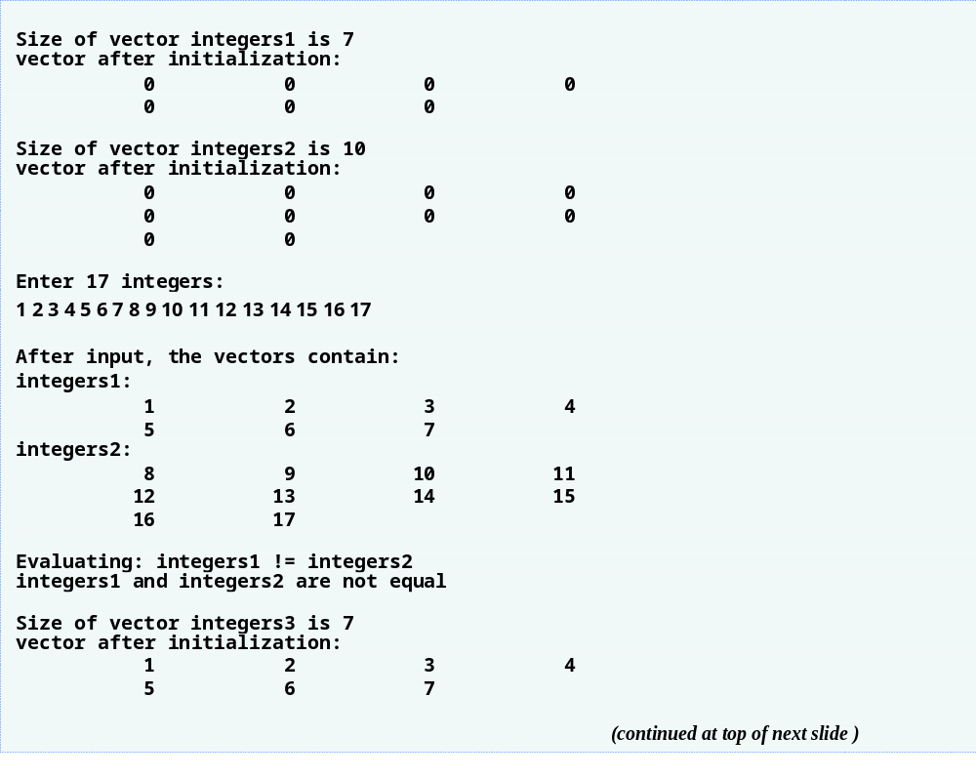
Outline
fig07_26.cpp
(5 of 6)

Slide 72
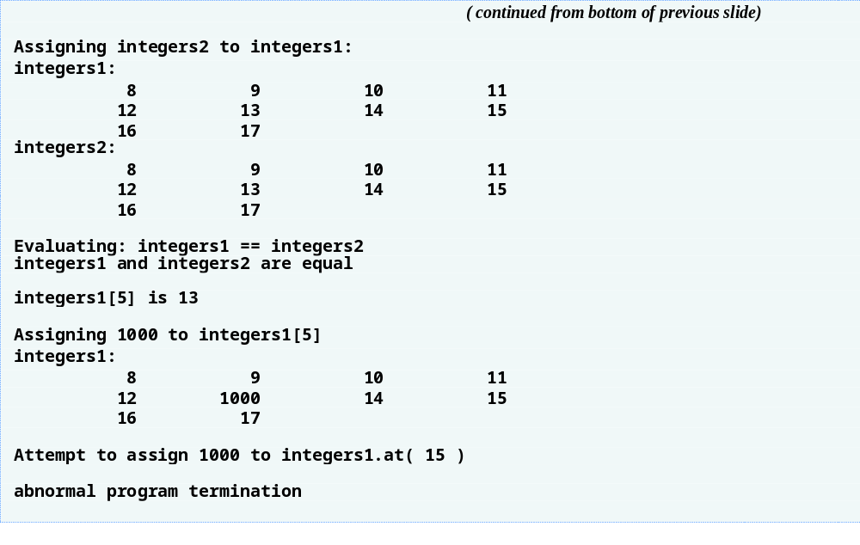
Outline
fig07_26.cpp
(6 of 6)
Call to function at with an invalid subscript terminates the program

